Slide 1
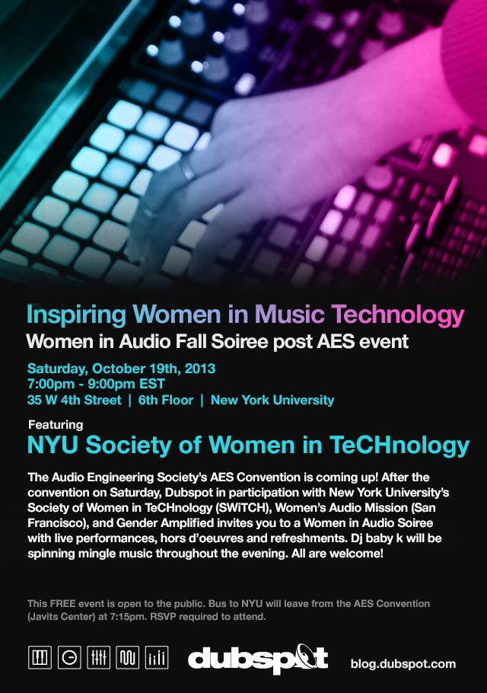
POP-UP BAND
Collaborative workshop for Mutek 2015

Slide 2
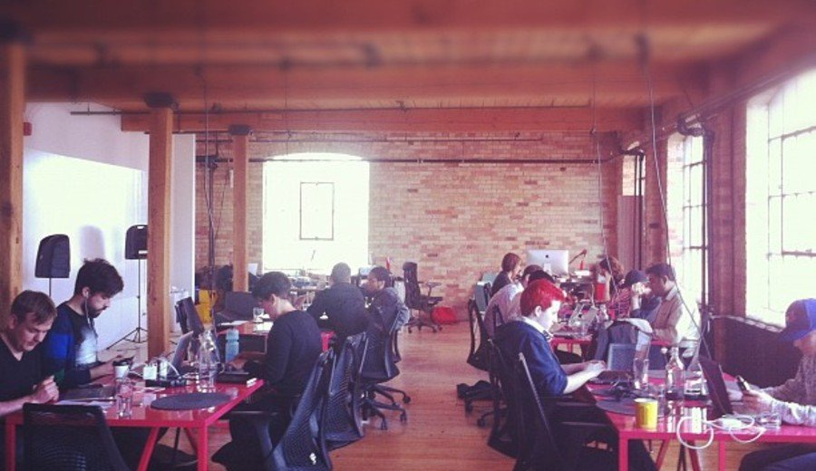
POP-UP Band @ Mutek 2015
POP-UP BAND
Collaborative workshop
DAY ONE: Experiment + Play Create a short piece of music in teams of three
Explore new tech tools to inspire creativity
Encourage new approaches for developing content
Diversify creative process and learn from teamwork
Follow progress with six creative mentors
Day TWO : Performance + Vision
Set objectives and approach as a band
Cultivate band identity including name, logo and bio
Create a social media presence
Mix track created on Day One
Prepare a performance
Leave with recording and documentation

Slide 3
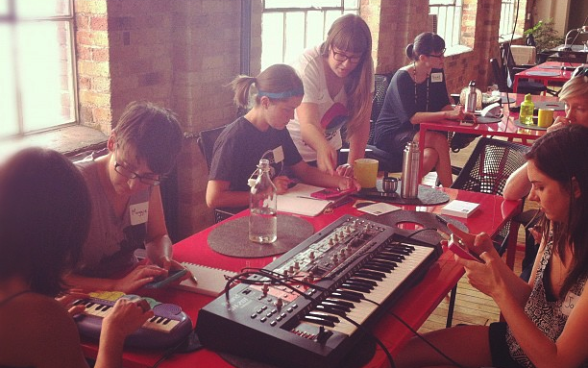
POP-UP Band @ Mutek 2015
OBJECTIVES
The workshop’s emphasis is on collaboration and the creative process
Learn electronic music production/ recording/mixing techniques and execute through the creation of an original production
Use new tools in music making under the supervision of creative mentors
Form a band of three peers: Follow steps of creating music as a team and preparing a short onstage performance of your team’s work.
Focus on marketing, branding and social media identity. Simulate and proceed with the first steps of breaking into the global music tech industry
Notes:
WHAT ITS FOR

Slide 4
POP-UP Band @ Mutek 2015
DEMOGRAPHICS
For Tech savvy musicians, between 17 to 35,
Wanting to collaborate in music making process,
Have done some audio work in the past (beginners to intermediate),
Students, young multidisciplinary artists & musicians,
Electronic music producers, beatmakers, singers,
French, english and/or german speaking.
Notes:
WHAT ITS FOR

Slide 5
POP-UP Band @ Mutek 2015
LOGISTICS
24 participants
6 coaches
6 spaces (production spaces, studio, concert)
2 days (10am to 8pm)
Multilingual (german, french, english, spanish)
+bring your own lunch (?)
+one or two lap tops for each team
50$ per participants
+bonus gifts
+chance to win some music making tools
+leave with a professional demo

Slide 6
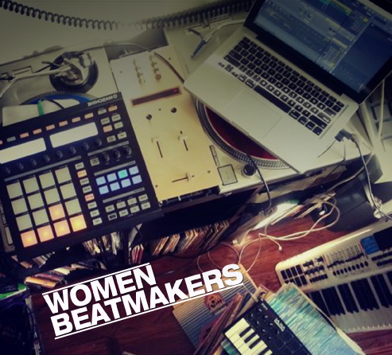
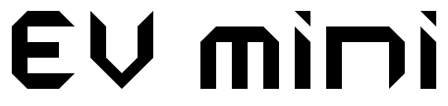
POP-UP Band @ Mutek 2015
Presented by
Women Beatmakers and EV MINI
Women Beatmakers is a monthly meetup group hosted at Dubspot NYC, comprised of women producers looking to network, collaborate and share their musical creations with like-minded individuals.
EV MINI is the educational branch of Evelyne Drouin, also known as Dj Mini. Her body of work as a DJ and electronic music producer has earned her an international reputation as one of the most influential canadian sound artist and performer.

Slide 7
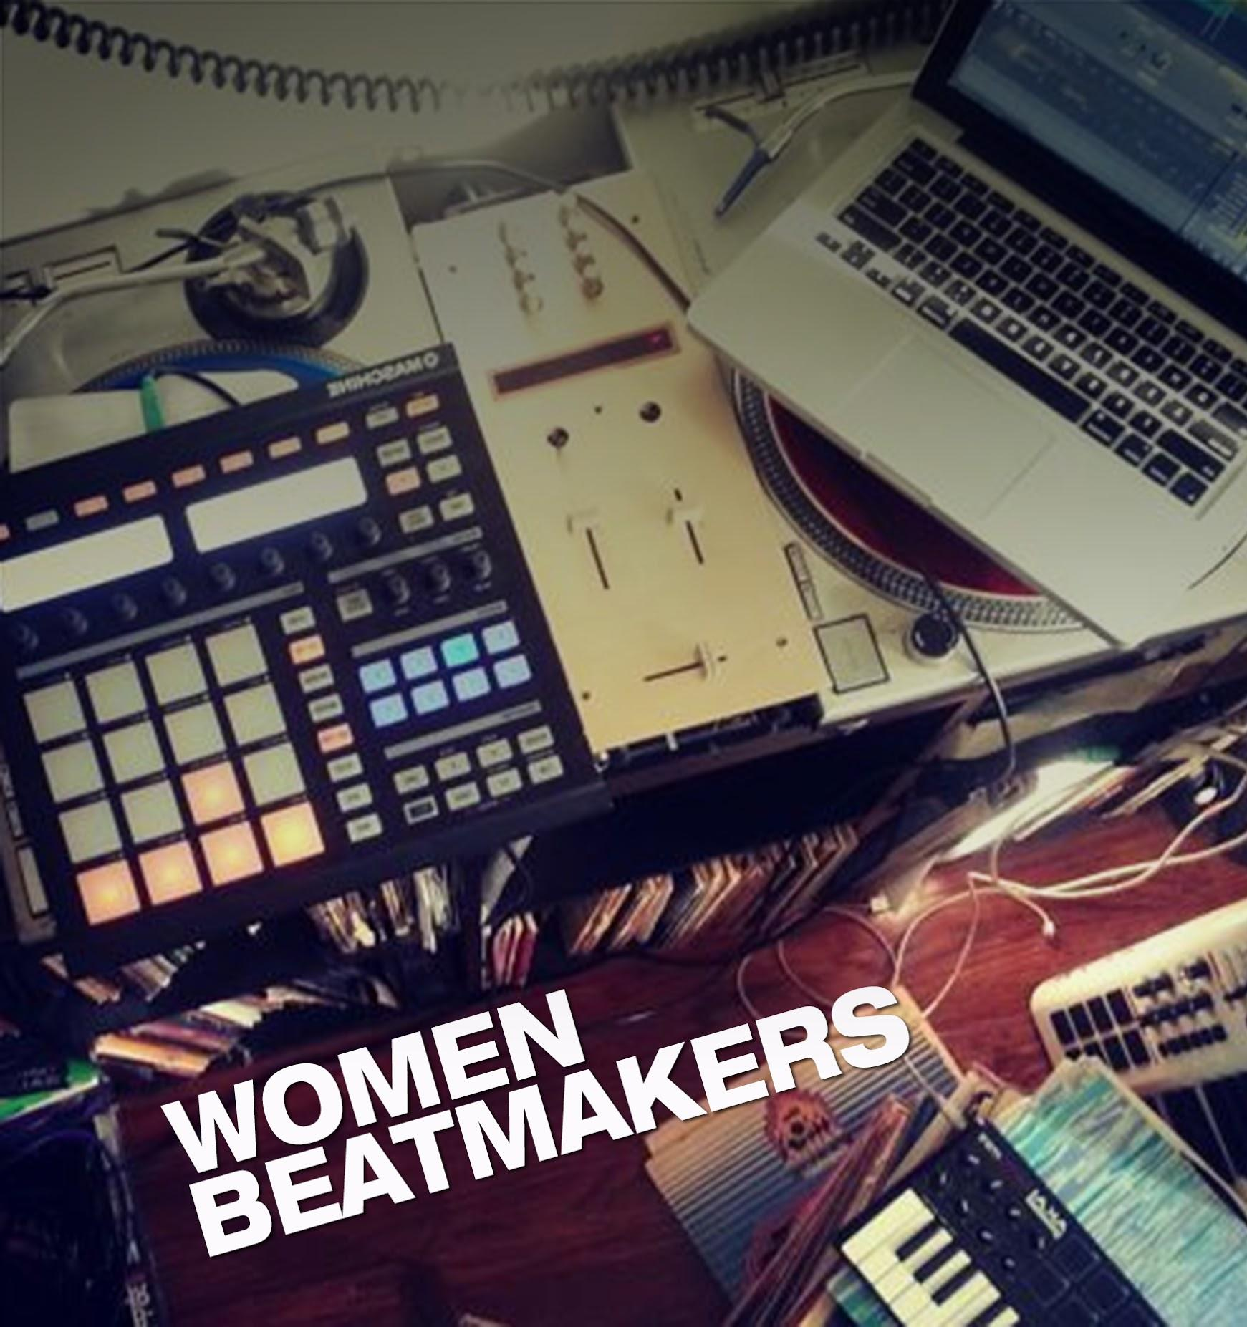
POP-UP Band @ Mutek 2015
Women Beatmakers mentors
EV MINI mentors
Kristen “Pozibelle” Glennon - Producer & DJ
Dubspot NYC
founding member of Women beatmakers
Kelly Webb - DJ & marketing, communications
Dubspot NYC
founding member of Women beatmakers
Michele Darling - Producer
Director of education @ Dubspot
founding member of Women beatmakers
Evelyne Drouin aka DJ MINI / EV MINI
djmini.com
Canadian sound artist and performer
spoken and written : french + english
Miquel Olivares aka Darth Mike & Lilithmusic
Spanish sound artist and performer
spoken and written : spanish + french + english
Special guest (TBC)

Slide 8
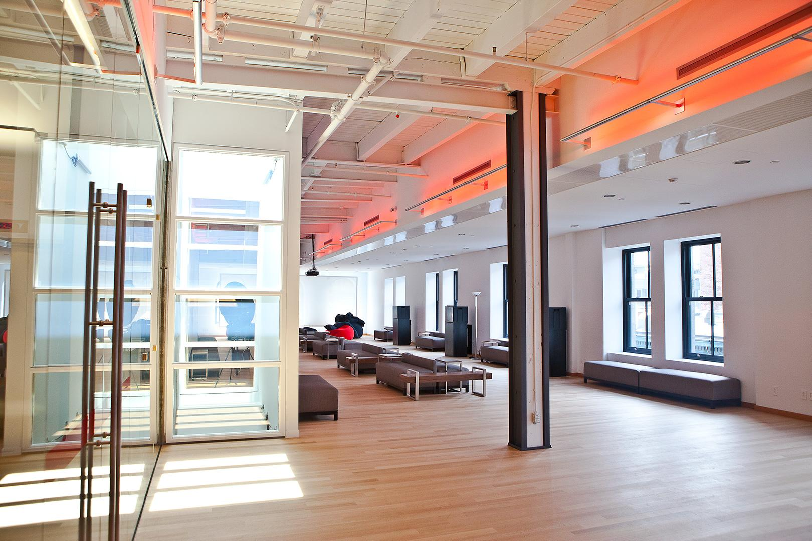

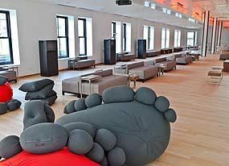
POP-UP Band @ Mutek 2015
Location : PHI Center, Old Montreal
Dates : 27th, 28th of May 2015
CREATING A GATHERING PLACE FOR ART
Phi’s mission is to make art accessible to as many people possible and to foster encounters and exchanges of all kinds between artists, the work and the audience. By creating a gathering place for art, Phi also makes art essential.

Slide 9
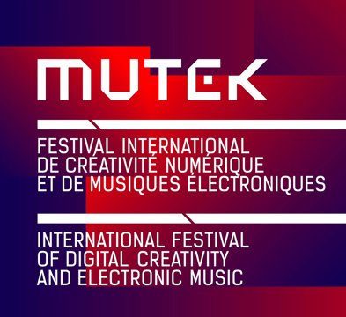
MUTEK is a not-for-profit organization dedicated to the dissemination and development of digital creativity in sound, music, and audio-visual art.
Its mandate is to provide a platform for the most original and visionary artists currently working in their fields, with the intent of providing an outlet of initiation and discovery for the audiences we seek to develop.

